Slide 1
The cococap hr analytics report
Oyinda Olatunde

Slide 2
outline
Executive Summary
Introduction
Methodology
Results
Findings
Conclusion

Slide 3

Executive summary
In our data analytics project for Cococap, we conducted a comprehensive analysis of HR data from a dataset containing 22,214 records and 13 columns. The project involved rigorous data cleaning and preprocessing to ensure data quality. Leveraging Power BI for visualization, our analysis revealed critical insights into employee demographics, turnover rates, departmental trends, and tenure analysis, empowering Cococap with actionable recommendations for strategic HR decision-making.

Slide 4
Introduction
In this presentation, we delve into a HR Data Analytics project for Cococap, where I've rigorously analyzed a dataset containing 22,214 records and 13 columns. I focus on data cleaning, preprocessing, and visualization through Power BI has uncovered vital insights and trends to inform strategic HR decision-making.

Slide 5



methodology
MySQL
Power BI
GitHub
MySQL serves as the data storage and management system, housing the HR dataset for seamless access and retrieval in real-time.
Power BI is our tool of choice for data visualization, providing interactive dashboards and reports to convey key insights from the HR data effectively.
GitHub plays a central role in collaboration and version control, ensuring that the project is efficiently shared, tracked, and improved by the team.
This Photo by Unknown Author is licensed under CC BY-ND

Slide 6
Results

Slide 7
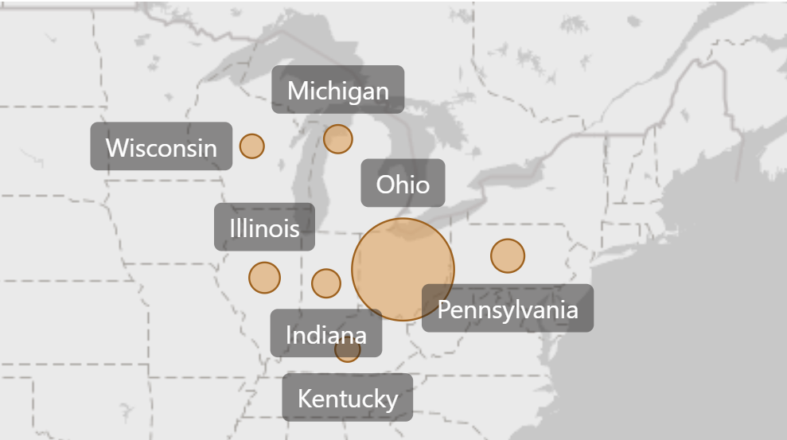
results
Employee count by state
The result from the analysis show the density of employees in each state.

Slide 8
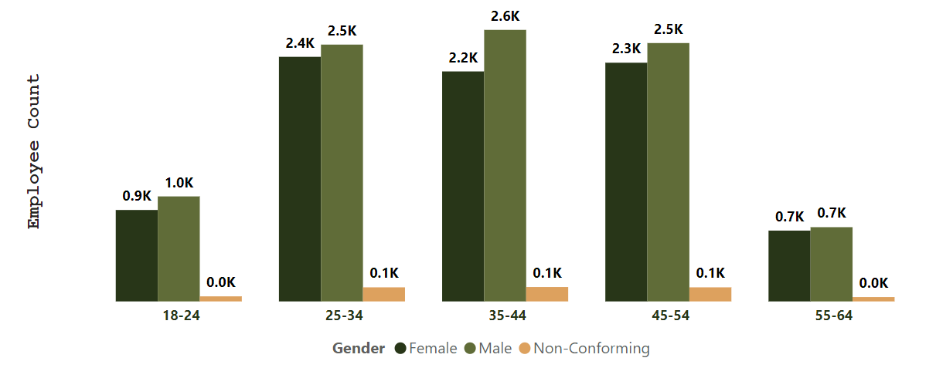
results
Age distribution by gender
The result from the analysis show the distribution of age across genders. Here we can see that there are a higher number of male employees in each age group, with the majority of employees being between the ages of 25 and 54.

Slide 9
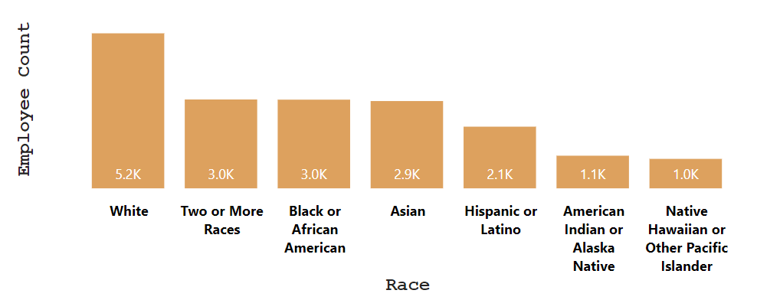
Result
Race distribution
The result from the analysis show the distribution of race within the company. Here we can see that white employees make up the larger racial group within the company, with the Native Hawaiian or Other Pacific Islander employees being the minority.

Slide 10
findings
1.Gender Breakdown: The company has more male employees, but there is a gender balance between male and female employees. However, a very small number of the company identify as gender non-conforming.
2. Race/Ethnicity Diversity: White employees make up the largest single racial group within the company. However, the company has a good distribution of employees who are not white. With the total number of POC (people of colour) employees being greater than the number of white employees.
3. Age Distribution: Most of the employees are between the ages 25 - 54. Less than 1.5k employees are above the age of 55 and less than 2k employees are between the ages 18 - 24.
4. Location Distribution: Nearly 75% of the employees work at the headquarters, versus remote locations.
5. Average Tenure of Terminated Employees: The average length of employment for employees who have been terminated is 7 years.

Slide 11
findings
6. Employee Distribution in Departments: Most of the employees work within the engineering department. Accounting comes second. The least amount of employees work within the auditing department.
7. Turnover Rate by Department: The auditing department has the highest turnover rate of 0.15.
8. Location of Employees: Ohio has the highest number of employees, at 14,788. The remaining employees are distributed nearly evenly across Michigan, Pennsylvania, Illinois, Indiana, Kentucky, and Wisconsin.
9. Employee Count Trend: The rate of termination has increased while the rate of hire has gone down by a bit, but not much.

Slide 12
conclusions

Slide 13
conclusion
In conclusion, the HR analytics project revealed a relatively balanced gender distribution, a diverse racial/ethnic composition, and a predominant age group of employees between 25 and 54. The majority of employees work at the company's headquarters, and the average tenure of terminated employees is 7 years. Engineering and accounting departments have the highest employee counts, while the auditing department experiences the highest turnover rate. Ohio houses the largest workforce, and there's a concerning trend of increasing terminations with a slight decline in hiring.

Slide 14
Thank you
Please feel free to share this presentation​
Oyinda Olatunde
oyinda.olatunde@gmail.com​

